Slide 1

PROJECT 3
Subreddits: Oculus vs Vive
Kelvyn, Shauna, Munish, Radhe

Slide 2
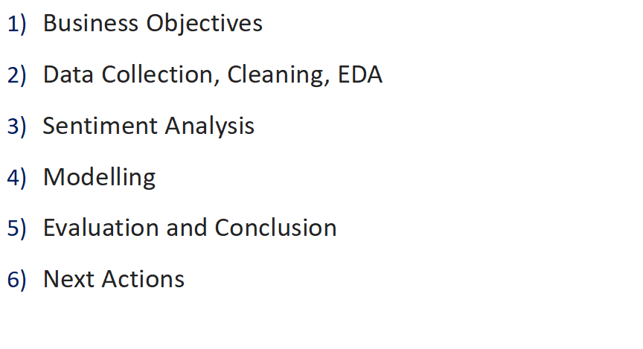
Agenda

Slide 3

Business Objective - Background
Business Overview : YourBackoffice - Org chart relevant to project - today
YourBackoffice
HQ - Paris
YourBackoffice Support Team
YourBackoffice Customers
Facebook Support
Singapore
Facebook
Supplier Enablement
Oculus support
HTC Support
Troy, MI, USA
HTC
CorpApp, ITO, BPO

Slide 4
Business Objective - New Emerging business situation
Business Overview : YourBackoffice - Org chart relevant to project From Jan 2020
YourBackoffice
HQ - Paris
YourBackoffice Support Team
YourBackoffice Customers
Facebook Support
Singapore
Facebook
Supplier Enablement
Oculus support
HTC Support
Troy, MI, USA
HTC
CorpApp, ITO, BPO

Slide 5
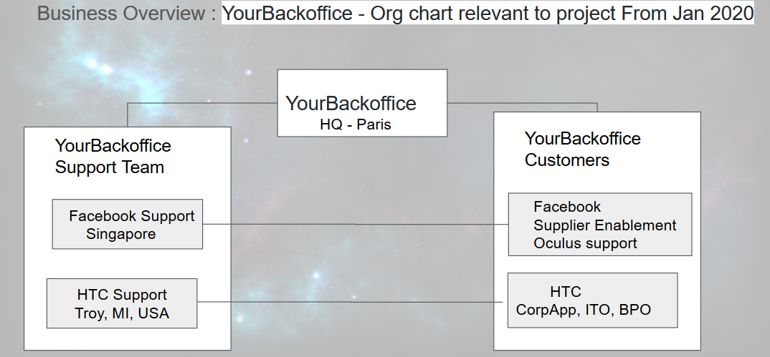
Business Objective - How Emerging business situation impacts us ?
Why are we involved ?
We - Data Science Team @YourBackOffice

Slide 6
Business Objective Emerging business situation triggered something ?
Why are we involved ?
We - Data Science Team @YourBackOffice
Facebook complain to our COO raising concerns on checkpoint delays after Oculus service dry run failure - - Oculus requests not getting through to identified FacebookSupport service staff at YourBackOffice.

Slide 7
Business Objective
Why are we involved ?
We - Data Science Team @YourBackOffice
are engaged to do critical service recovery by building a classification model
Route Oculus requests to Facebook support team @SGP
Route Vive requests to HTC support team @USA
Facebook complain to our COO raising concerns on checkpoint delays after Oculus service dry run failure
Oculus requests not getting through to identified FacebookSupport service staff at YourBackOffice.
Corporate System routes all VR matters on all channels to internal HTC support team at USA
IT vendor activated to make the system change but it will take 1+months
Show stopper for Oculus Service transition by 01-Jan-2020

Slide 8
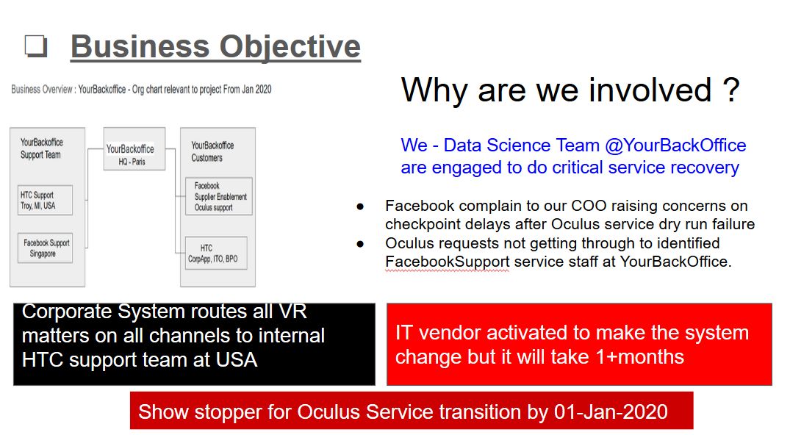
Business Objective
Why are we involved ?
We - Data Science Team @YourBackOffice
will build a NLP classification model
Route Oculus requests to Facebook support team @SGP
Route Vive requests to HTC support team @USA
We - Data Science Team @YourBackOffice are engaged to do critical service recovery to enable Oculus Service transition by 01-Jan-2020

Slide 9
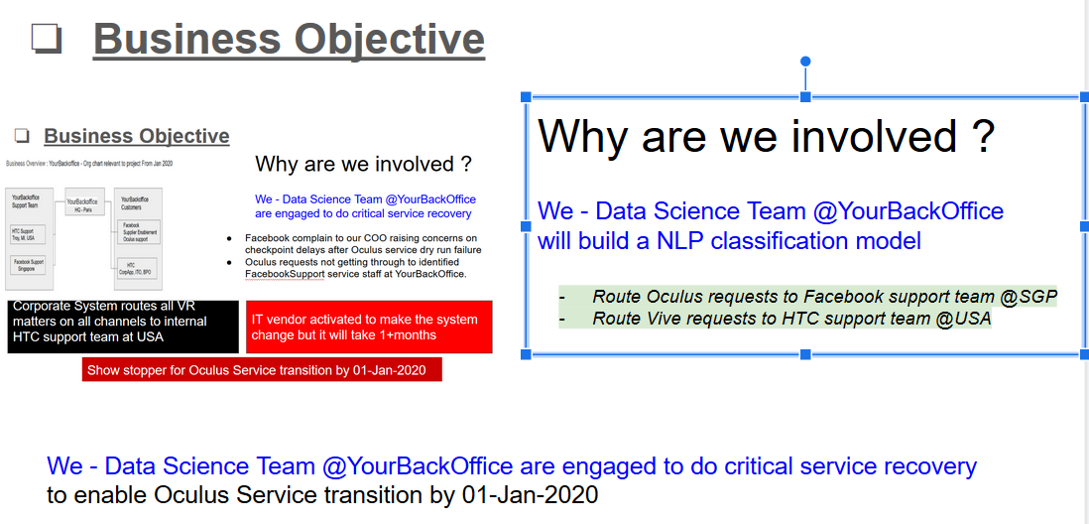
Business Objective
Why Reddit ?
HTC contract clause does not allow data sharing outside USA. Negotiation for exceptional waiver ongoing
Facebook in the process of preparing data to share in a week’s time.
We proposed to use Reddit to do interim development towards a Classification model POC by 12-Dec-2019 which will be extended to work with actual data set when available.
This POC will also enable to do a POC on sentiment analysis on reddit dataset which will be extended to enable facebook account management team be better informed about market sentiment.

Slide 10


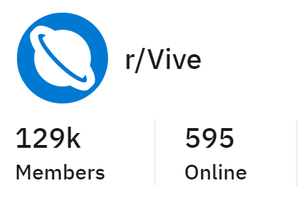
Data Collection
150 posts
150 posts
Collected 150 posts from each Subreddit.
Data Parameters: ‘Titles’, ‘Times’, ‘Subreddits’, ‘Comments’, ‘Upvotes’.

Slide 11




Data Cleaning
1) Parse and pull the raw text out from the JSON file saved from reddit
3) Remove common English stop words using the NTLK package
Snowball
Stemmer
2) Filter out non-alphabetic characters
4) Normalize the text by reducing words to their base form

Slide 12
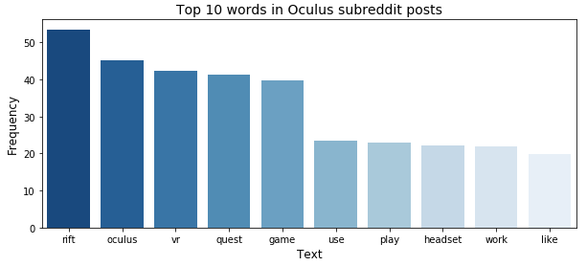
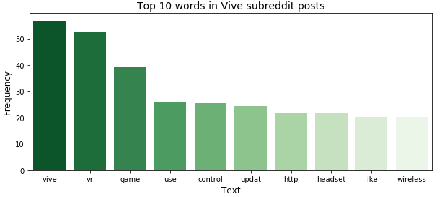
Top Words
Common Words
‘vr’
‘Game’
‘Quest’
‘like’

Slide 13
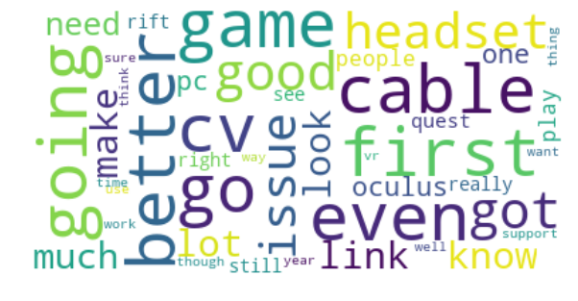
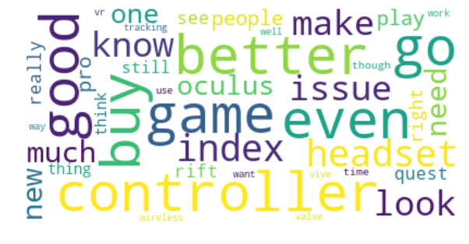


Top Words

Slide 14
Sentiment Analysis
Library of words
2005
Positive Words
4778
Negative Words
Reference:
Jeffrey Breen, Head of Data Engineering and Data Science, GMO
https://github.com/jeffreybreen/twitter-sentiment-analysis-tutorial-201107/tree/master/data/opinion-lexicon-English

Slide 15
Sentiment Analysis
Split the subreddit text into individual words
Count the number of positive and negative words in subreddits
Tokenization
Sentiment Count
Lemmatization
Sentiment Percentage
Lemmatize all positive and negative words from github source
Compute sentiment percentage for each word and mean of all text

Slide 16
Sentiment Analysis
0.0285
<
0.0437
Limitations:
The list of positive and negative words are not exhaustive.
The list of words I chose for positive and negative words may be chosen out of context.

Slide 17
Baseline Accuracy
0.519
0.481
Notes:
Preprocessing + Modelling

Slide 18
Choosing
the right vectorizer?
Notes:
Now the text data is cleaned it is not quite ready for modelling. I first have to convert the text into a numerical form. I experimented with 2 different vectorisers to see which one was best and used a fast and simple classifier (logistic regression) model in a Pipeline

Slide 19
TfidfVectorizer
CountVectorizer
LogisticRegression
LogisticRegression
Notes:
TfidfVectorizer and CountVectorizer both are methods for converting text data into vectors as model can process only numerical data.
In CountVectorizer we only count the number of times a word appears in the document which results in biasing in favour of most frequent words. this ends up in ignoring rare words which could have helped is in processing our data more efficiently.
In TfidfVectorizer we consider overall document weightage of a word. It helps us in dealing with most frequent words. Using it we can penalize them. TfidfVectorizer weights the word counts by a measure of how often they appear in the documents.

Slide 20

Scores / Pipeline | Pipeline w CVEC | Pipeline w TVEC
Best Score | 0.872 | 0.839
Train Score | 1.0 | 0.849
Test Score | 0.840 | 0.810
Highly Overfitting!

Slide 21
Choosing
the right classifier model?
Notes:
Logistic regression is a linear classification method that learns the probability of a sample belonging to a certain class. Logistic regression tries to find the optimal decision boundary that best separates the classes.
Naïve Bayes is a classification method based on Bayes’ theorem that derives the probability of the given feature vector being associated with a label. Naïve Bayes has a naive assumption of conditional independence for every feature, which means that the algorithm expects the features to be independent which not always is the case.
The first similarity is the classification use case, where both Naive Bayes and Logistic regression are used to determine if a sample belongs to a certain class

Slide 22
LogisticRegression
MultinomialNB
LogisticRegression
TfidfVectorizer
TfidfVectorizer

Slide 23
Scores / Pipeline | Pipeline MNB | Pipeline LogReg
Best Score | 0.828 | 0.839
Train Score | 0.832 | 0.849
Test Score | 0.800 | 0.810
Notes:
Naïve Bayes assumes all the features to be conditionally independent. So, if some of the features are in fact dependent on each other (in case of a large feature space), the prediction might be poor.
Logistic regression splits feature space linearly, and typically works reasonably well even when some of the variables are correlated.

Slide 24
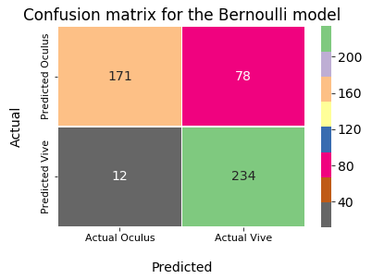
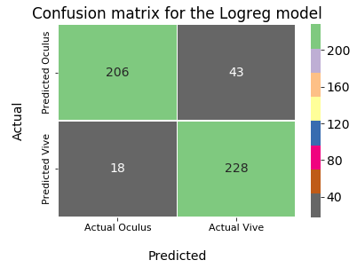
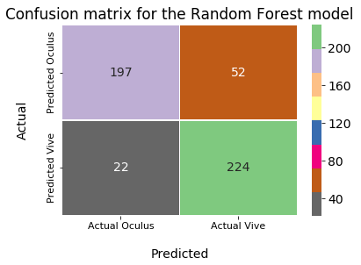
Confusion Matrices
Overall model accuracy: 82%
Vive prediction accuracy: 95%
Oculus prediction accuracy: 69%
Overall model accuracy: 88%
Vive prediction accuracy: 93%
Oculus prediction accuracy: 83%
Overall model accuracy: 85%
Vive prediction accuracy: 91%
Oculus prediction accuracy: 79%

Slide 25
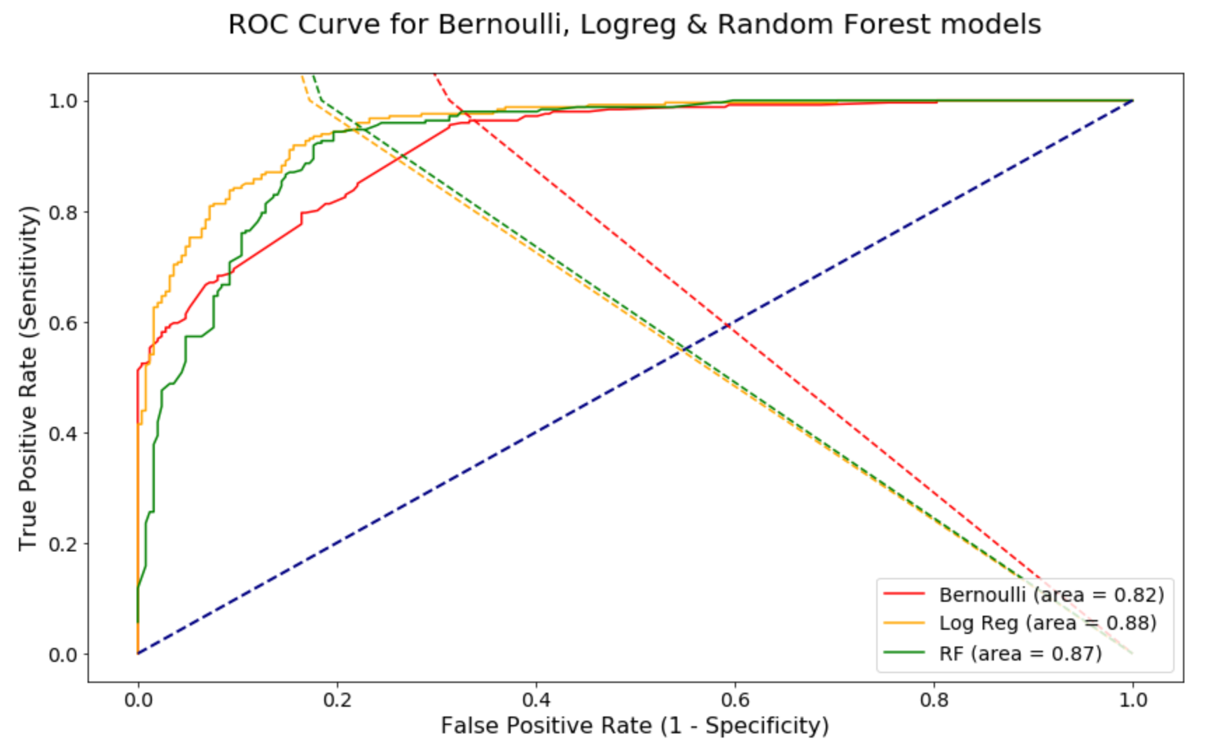
Conclusion
ROC Curve model ranking (AUC)
Logistic Regression (0.88)
Random Forest (0.87)
Bernoulli (0.82)
Model Selected: Logistic Regression
Train score in the 0.8 range
Model accuracy 88%, has high specificity and sensitivity

Slide 26
Limitations
Data source only from Reddit, a more comprehensive model should include datasets from other forums/review pages
A larger sample size could be used (only 1000 posts from each subreddit were used)
Model is only trained in English, and that leaves out the rest of the non-english speaking market
Consider a neutral VR focused forum to be used as a test set

Slide 27
Future Work

Slide 28
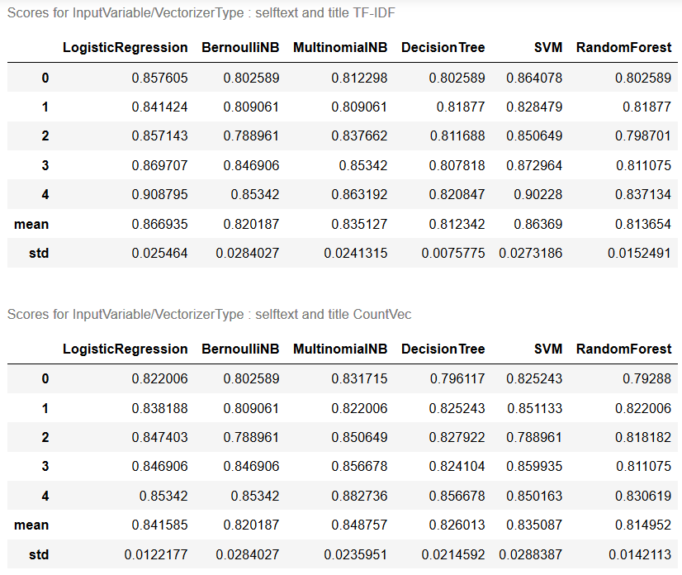
Next actions - Potential Future Work
- Cross validation summary of 6 NLP models using TFID and CountVectorized combined text of ‘selftext’ & ‘title’
Recap of work done so far:
Scope of POC was to build a classification model to identify the type of questions customers have and determine if they should be serviced by
- Our Facebook support team based in Singapore (if VR headsets requests received in our system are related to Oculus) or
- Our HTC team based in USA(if VR requests received in our system are related to Vive)
Next Actions
- 3 models(NB,LR, SVM) are tuned for dataset used with and ready to be potential candidates for adaptation as per actual data
- Other models and other code segments are also kept AS IS for potential selection or to adapt as per actual data after performing EDA on actual data.

Slide 29
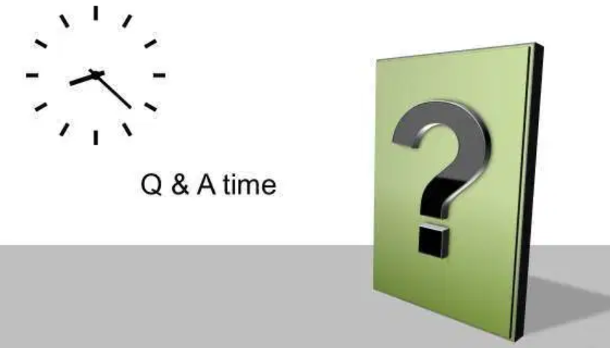

Questions ?

Slide 30
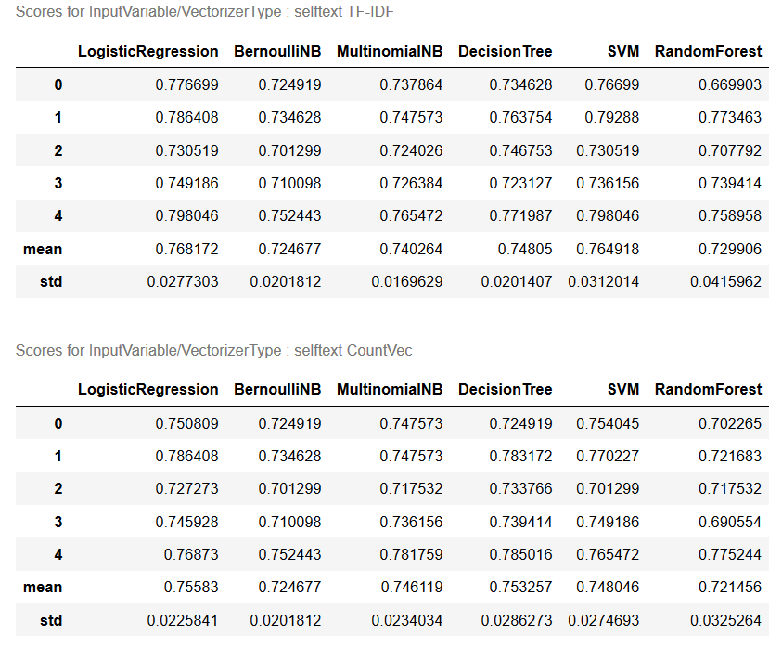
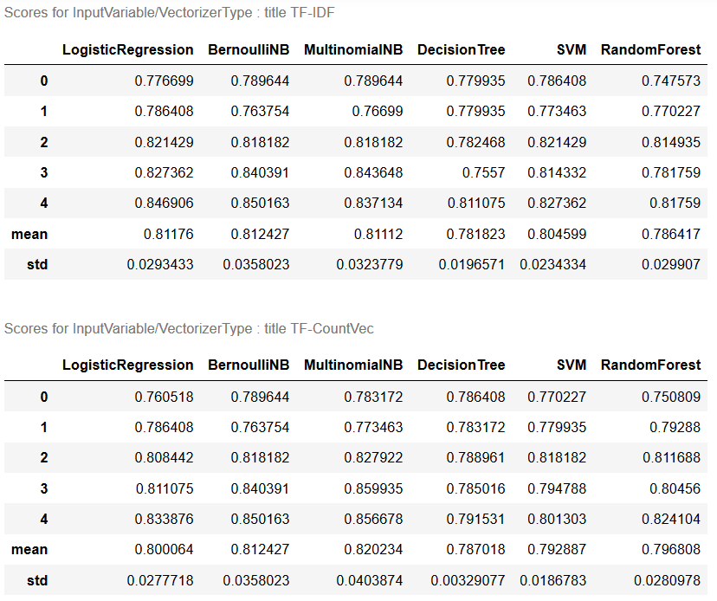
Next actions - Potential Future Work
- Cross validation summary of 6 NLP models using TFID and CountVectorized input variables ‘selftext’ and ‘title’

Slide 31
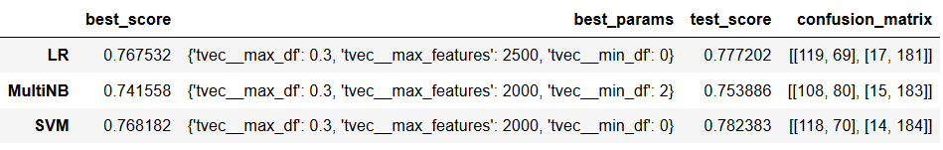
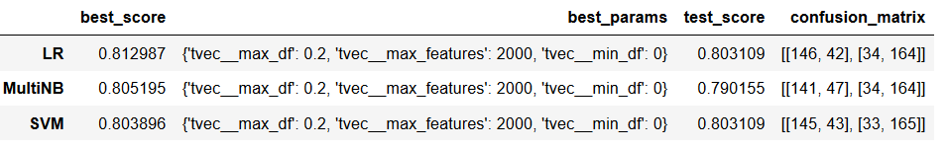
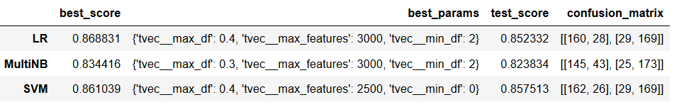
Next actions - Potential Future Work

Slide 32

More Questions ?

Slide 33
Business Objective (Munish) Who are We? - Upcoming new tech startup considering to enter into VR headset and getting a feel of the current market by zooming into the 2 big players: Oculus and Vive Why Reddits? - Subscriber base - Easy to scrap - Neutral platform - International base - Gaining popularity + outreach Why Oculus and Vive? - The top 2 big players of VR headset: Oculus and Vive
Problem Statement (Munish) - Finding out about user needs and preferences as comments on reddits usually reflects very positive/negative experiences of each individual products.
Data Collection (Munish)
Data Cleaning + EDA (Kel)
-> Barplot (Kel)
Visualisation - Word Cloud (Shauna)
Preprocessing + Modelling: Tvec (Shauna)
Cvec (Radhe)
Pipeline (Radhe)
Model Evaluation (Radhe)
Confusion Matrix (Kel)
Conclusion + Recommendation (Kel)
Limitations (Kel)
- Solely the mentions at one site, need to consider other sources of reviews - Need to consider the price point and functionality of the two products
Future Work - Compare Sentiment Analysis between 2 models (Shauna) -

